Slide 1
Education in India - Statewise Overview
Presented By: Team UnCensored

Slide 2
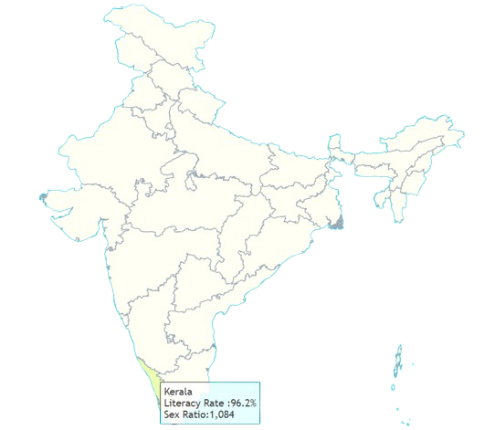


Literacy Rate in Indian States
India's literacy rate has improved over the years but remains varied across states.
- Kerala: 96.2%
- Andhra Pradesh: 66.4%
- National average: 77.7% (2023)
Challenges: Regional disparities, gender gap, rural-urban divide.
Sex Ratio in India
Sex Ratio: Females per 1,000 males
- Kerala: 1,084
- Chandigarh: 818
- National average: 943 (2011)
Improvements are needed to bridge the gender imbalance, especially in education access.

Slide 3
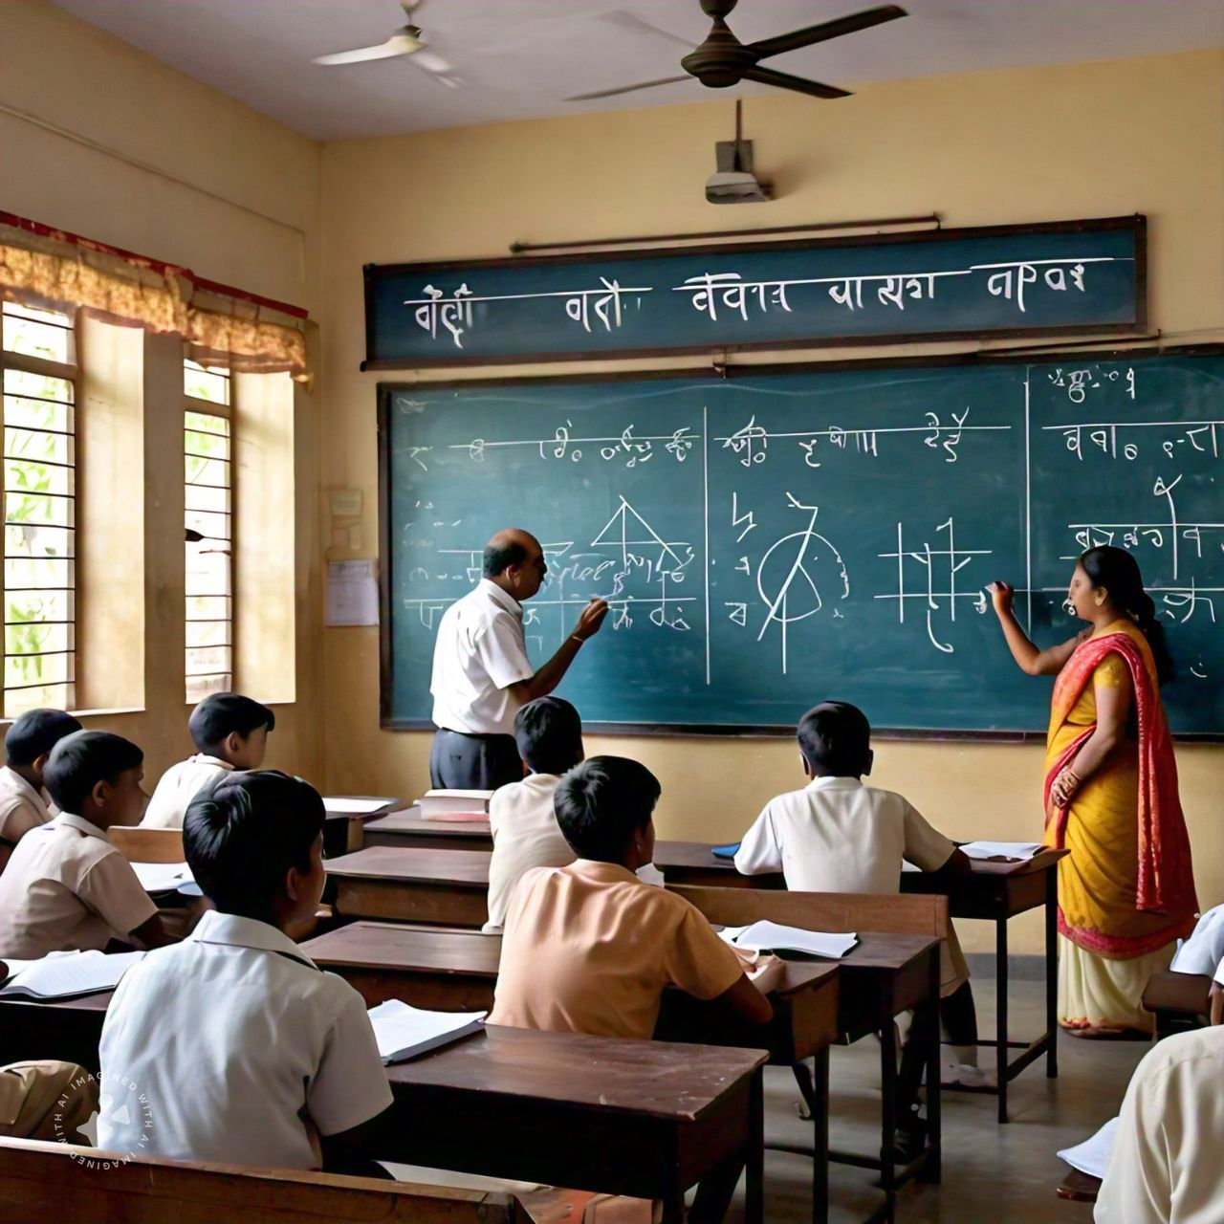

Pros and Cons of the Indian Education System
Pros:
- Strong focus on theoretical knowledge
- Extensive curriculum across subjects
- Competitive exams drive academic excellence
Cons:
- Lack of practical exposure
- Rote learning and memorization culture
- Uneven access to quality education in rural areas

Slide 4
Areas for Improvement
- Curriculum modernization: More focus on skill-based learning
- Technology integration: Use of digital tools in rural and remote areas
- Gender parity: Encouraging equal opportunities for boys and girls
- Teacher training: Enhancing the quality of educators
- Addressing dropout rates: Especially in secondary education

Slide 5
Slogans for Education Initiatives
1. 'Beti Bachao, Beti Padhao' (Save the girl child, Educate the girl child)
2. 'Padhega India, Toh Badhega India' (If India studies, India progresses)
3. 'Education for All: Sabko Shiksha, Achhi Shiksha' (Education for everyone, quality education)
4. 'Right to Education: Every Child's Right'

Slide 6
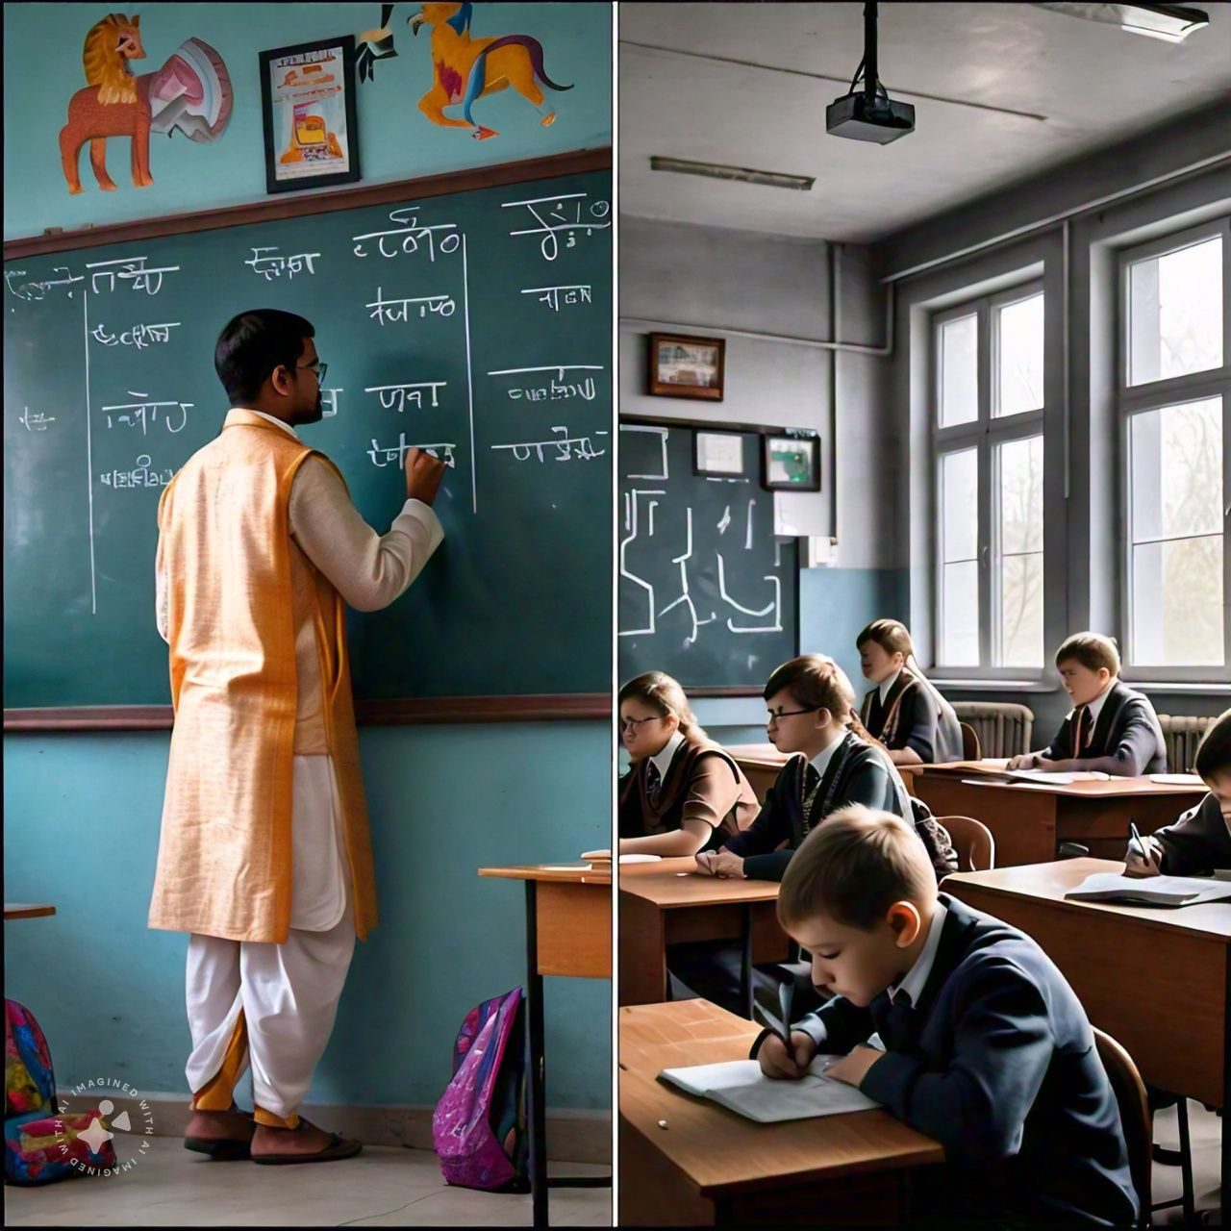
Comparison: Indian vs. Global Education System
Indian Education System:
- Focus on theoretical knowledge
- Exam-driven learning
- Limited vocational and skill-based training
Global Education System:
- Emphasis on practical and experiential learning
- Greater use of technology and digital education
- Holistic development: More focus on creativity and critical thinking
Key Takeaway: India needs to integrate practical learning methods, global trends, and more personalized education.

Slide 7
Conclusion
Education is the foundation of a nation's growth. India has made significant progress but needs further reforms.
Equal access to education, improved infrastructure, and updated curriculum will pave the way for a better-educated India.

